Slide 1

Developing hybrid applications with Kivy
By Wendinoda Washaya

Slide 2
What is Kivy???
Kivy is a python framework for developing hybrid GUI applications
One can develop for Android, iOS, OSX, Linux and Windows platforms
For Android the native libraries for Java can be accessed using other python libraries

Slide 3


Installation and dependencies
Do simple pip install
pip install kivy
Its dependencies are pygame and cython
Recommend installing a wheel file for widows i.e do a pip install for pygame
On a Linux machine
-pip install hg+http://bitbucket.org/pygame/pygame
python -m pip install docutils pygments pypiwin32 kivy.deps.sdl2 kivy.deps.glew
python -m pip install kivy.deps.gstreamer --extra-index-url https://kivy.org/downloads/package

Slide 4

Online resources
Kivy projects github
https://github.com/kivy/kivy/wiki/List-of- Kivy-Projects
Kivy documentation
https://kivy.org/ Kivy

Slide 5
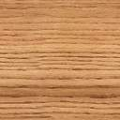
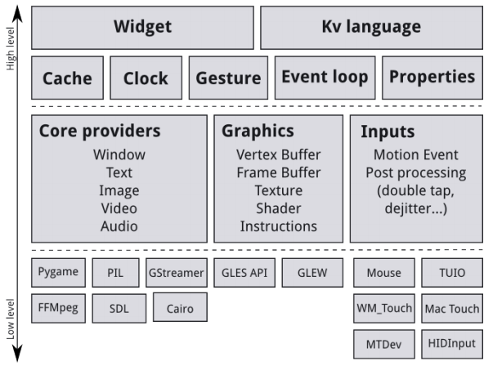
Architecture

Slide 6
cont
Core Providers
They aim to abstract internals such as opening windows, displaying images and text, audio playing and getting images from camera
For example, on OSX, Linux and Windows, there are different native APIs for the different core tasks.
The graphics of kivy are an abstraction of opengl

Slide 7
Widgets & Layouts
The UIX module contains commonly used widgets and layouts that you can reuse to quickly create a user interface.
Widgets are user interface elements that you add to your program to provide some kind of functionality. They may or may not be visible. Examples would be a file browser, buttons, sliders, lists and so on. Widgets receive Motion Events.
Layouts are used to arrange positions of the widgets. Examples would be Grid Layouts or Box Layouts. Its possible to nest layouts

Slide 8
cont’
Widgets in Kivy are organized in trees. Your application has a root widget, which usually has children that can have children of their own. Children of a widget are represented as the children attribute, a Kivy ListProperty.
The widget tree can be manipulated with the following methods:
add_widget(): add a widget as a child
remove_widget(): remove a widget from the children list
clear_widgets(): remove all children from a widget

Slide 9

Input Events (Touches)
Kivy is able to handle most types of input: mouse, touchscreen, accelerometer, gyroscope, etc.
The class of all input events is the motion event. It generates 2 kinds of events:
Touch events: a motion event that contains at least an X and Y position. All the touch events are dispatched across the Widget tree.
No-touch events: all the rest. For example, the accelerometer is a continuous event, without position. It never starts or stops. These events are not dispatched across the Widget tree.

Slide 10
Cont’
The EventDispatcher class allows registering of event types and dispatches them to the respective recipient
Widget , Animation and Clock class are event dispatchers
To schedule use the Clock class, the Clock object allows you to schedule a function to call in the future; once or repeatedly at specified intervals
Scheduling will cause a function to be called repeatedly
To schedule an event use schedule_interval()
Events must also be unscheduled:unscheduled_interval()

Slide 11
Cont’
They are two types of events:
Property events : e.g if widget changes size or position an event is fired
Widget-defined events : e.g button press event
A custom event can be created
To create one register the name of the event in a class and create method with same name that is override the event method
To use events, you have to bind callbacks to them. When the event is dispatched, your callbacks will be called with the parameters relevant to that specific event.

Slide 12
Properties
Properties are an awesome way to define events and bind to them.
They produce events such that when an attribute of your object changes, all properties that reference that attribute are automatically updated.
A property is a class attribute that will automatically create instance
attributes.
There are different kinds of properties to describe the type of data you want to handle.
StringProperty
NumericProperty
ObjectProperty
ListProperty
BooleanProperty

Slide 13

Cont’
A property has to be declared . These properties are not attributes: they are mechanisms for creating events based on your attributes
After declaration Kivy properties, by default, provide an on_<property_name>event. This event is called when the value of the property is changed.

Slide 14
The magic of Kivy language
kv language is a specific kivy layout language
It separates the layout from the logic of the application
There are two ways to load Kv code into your application:
By name convention: Kivy looks for a Kv file with the same name as your App class in lowercase, minus “App” if it ends with ‘App’. e.g:
MyPyConApp -> mypycon.kv.
If this file defines a Root Widget it will be attached to the App’s root attribute and used as the base of the application widget tree.
Builder: You can tell Kivy to directly load a string or a file. If this string or file defines a root widget, it will be returned by the method: Builder.load_file('path/to/filename.kv')

Slide 15
cont’
In kivy language you can actually implement some functionality in python. Python modules can be accessed by doing an import with a slightly different syntax.
The language consists of several constructs that you can use:
Rules- A rule is similar to a CSS rule. A rule applies to specific widgets in your widget tree and modifies them in a certain way.
You can use rules to specify interactive behaviour or use them to add graphical representations of the widgets they apply to.
A Root Widget-You can use the language to create your entire user interface. A kv file must contain only one root widget.
Dynamic classes let you create new widgets and rules on-the-fly, without any Python declaration.

Slide 16
Packaging
We need to install Buildozer to create the package. From the shell in the selected location,
let's run:
$ git clone https://github.com/kivy/buildozer.git
Now go to the buildozer folder:
$ cd buildozer
Finally, we set up Buildozer with:
$ sudo python setup.py install
We also need to install python-for-android . We do it from this shell:
$ git clone git://github.com/kivy/python-for-android

Slide 17
Cont’
$ buildozer init
We build our distribution with:
$ ./distribute.sh -m "kivy"

Slide 18

Other important aspects !!!!!!!
Talk was only 30 minutes ☹
Other very important aspects of app development include
Local storage
Animation
Hardware access
Network access

Slide 19
cont’
For local storage-kivy.storage
For animation of widget properties - kivy.animation
For hardware access of devices-kivy.core(This module defines the abstraction layers for our core providers and their implementations)
If application requires some online resources - kivy.network (You can use the UrlRequest to make asynchronous requests on the web and get the result when the request is completed)

Slide 20

The END…..

